Slide 1
PEMANFAATAN MEDIA SOSIAL DALAM KOMUNIKASI PEMASARAN
By:
Nur Atnan, S.IP., M.Sc.

Slide 2
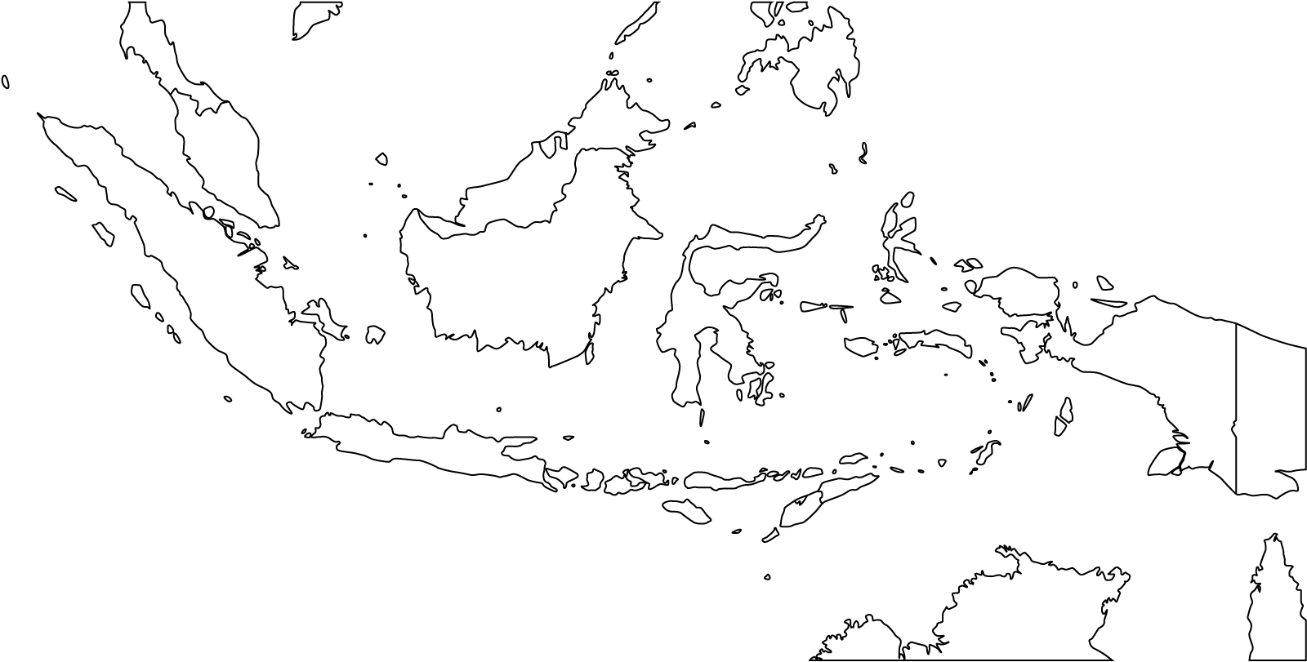
Big on Social Media/Interactivity
Facebook Users 4th global 60m
Jakarta No 1 most active Twitter city
Head of Country is on Twitter @sbyudhoyono
First lady in on Instagram @aniyudhoyono
Pop. 250 million
13,000 islands
300 hundreds languages
Democratic System
National and Local Election
Freedom of Media & Speech
Internet Users 25% or 60m
Mobile Phone Users 84%
Smartphone Users 24%
INDONESIA
Unique Culture
Specific Behavior
Communities and Groups are BIG
GDP US$ 3.5k per capita, Indonesia
GDP US$ 8k per capita, Jakarta
Extensive usage, projected growth in interactivity

Slide 3
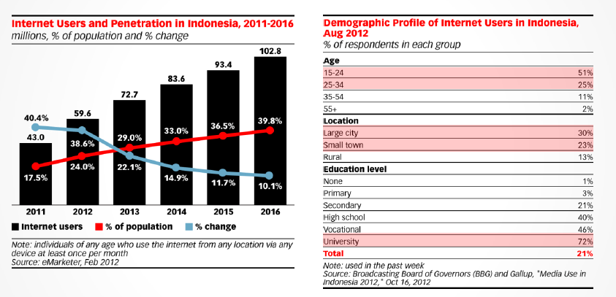
Internet Users Growing Fast
Indonesia Internet users will be 100m users in 2015 (40% penetration)
Majority Internet users are 15-24, University Graduates
Rural area lag behind with 13% Internet users

Slide 4
In %
Media Penetration Urban Indonesia 2009-2012
Internet the only medium that is growing
Source: eMarketer.com

Slide 5
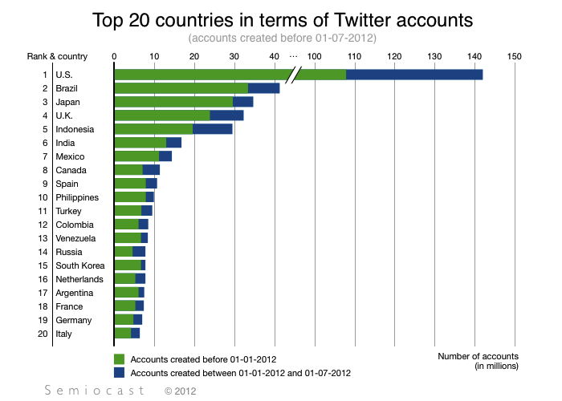
29 million twitter accounts

Slide 6
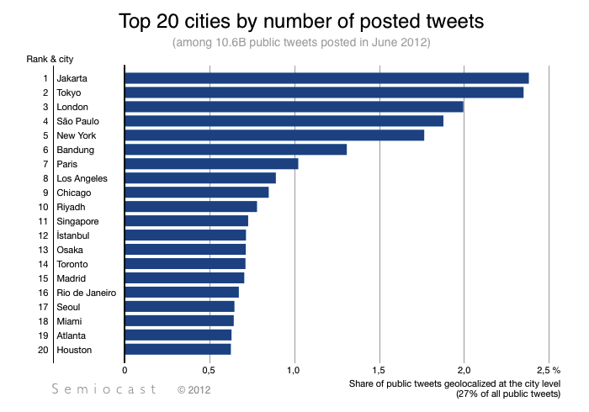

Slide 7
Information – Media – Influences
MSM Media
Social Media
Sources
What is “MEDIA”?
Mainstream Media:
- Validate Information
- Amplified Message

Slide 8
Internet Presences

Slide 9
New Media Communication Strategies
Content
Tools
Stakeholders
Policy
Communities

Slide 10
New Media Strategies: Policy
Objectives
Team Responsibilities
Audiences/ Platform
Official Accounts/ Personal Accounts
Social Media Guidance/Rules
Support for Social Media/Digital Team
Twitter
Facebook
Instagram
YouTube

Slide 11
New Media Strategies: Content
Content Plan
Content Sources
Content Composition
Activities Plan
Special Campaign
Regular Content
Formal/Official 40%
Informal 60%
Trivia Quiz
Time hop
#FollowFriday
#SaturdaySelfies
Weekly
Monthly
Media
Other Socmed Accounts
Modified for Social Media
More Pictures
Short/Informal
Questions okay

Slide 12
New Media Strategies: Tools
Scheduler:
Buffer App
Influencers:
Klout, Twopcharts
Team Management, Monitoring:
Topsy, Hootsuite
Measurments:
Keyhole.co, Tweetreach.com
Listening:
Google Alerts, Twitter Search
Communities:
Commun.it

Slide 13
New Media Strategies: Communities
Listen/Monitor
Mentions/ Answer
Retweet
Favorites
Offline Meetup:
KOPDAR
Follow/Personal Message

Slide 14
New Media Strategies: Stakeholders
Supporting Influencers
Active Users
Internal Personal Use
Other Official Accounts
Media Accounts
Ambassador
Journalists
Politicians
Gov. Officials
Celebritities (Tweet/Regular)
Business Leaders

Slide 15
Anatomy of a Social Media Campaign
Content
Basic Data
Whitepaper
Photos / Images
Logo / Symbols
Videos / Movies
Audios / Songs
Infographic
News Piece/Clips
Kultwits
Social Media
Mobile App
Mobile App
Campaign Identity
Dissiminate Information
Public Documentation / Archive
Coordinate Action
Pressure Groups
FB Pages
Blogs
FB Pages
WA/BBM Groups
Twitter Account
Twitter Account
Twitter Account
Twitter Account
Email List
Blogs
FB Pages
Blogs
FB Pages
Twitter Account
Youtube Channel
Youtube Channel
Offline Actions
Online Actions
Concerts
PressConf
Street Actions
Petitions
Hashtags
Selfie Contest
Avatars
Fundraising
Mainstream Media
Civil Society Groups
Key Influencers
Decision Makers
Targets
Public Awareness → Change in Policy

Slide 16
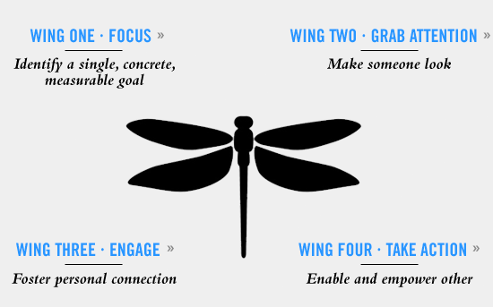
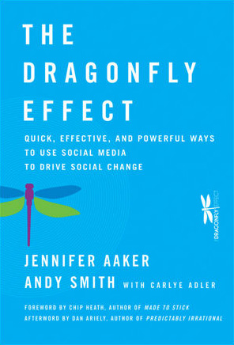
The Dragonfly Effect – Driving Social Change Trough Social Media
Professor Jennifer Aaker and her husband Andy Smith

Slide 17
FOCUS
Identify single, concrete, measurable goal
Humanistic
Actionable
Testable
Clarity
Happiness (Meaningful)

Slide 18
ATTENTION
Make someone look
Personal
Unexpected (Curiosity)
Visual (Photos, Videos, Logos)
Visceral (Emotions)
Key Messages
Why people care?
Start with a fact
Begin with a question
Be creative

Slide 19
ENGAGE
Foster personal connection
Tell stories
Empathies
Authentic
Relevant
Context

Slide 20
ACTION
Empower OTHER
Easy
Fun
Tailored
Open

Slide 21
Strategy – A Social Media Campaign
Values
Mission
Tactics
Who we are, Identified Problems
Audiences
Single, clear, meaningful, measureable goals: Build Communities, Change Policy, Increase Awareness
Messages
Supporting Mission, Relevant, Open, Fun, Unique
General Public, MSM Media, Decision Makers
Tools
Creative, Unexpected, Emotions, Visual, Participative, Easy
Social Media Platforms: Twitter, FB, Blogs etc.

